Slide 1


Stage of Development: MVP
RESTAURANT EXPANSION PLATFORM
Delivering Hot Meals Efficiently
Contact details
Name: Pranay Kukreti
Email ID: pranay@vendmat.com
Mob. No. 8859880922
1
www.vendmat.com

Slide 2
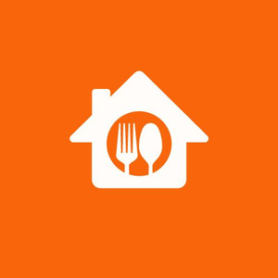




Problem
Inefficient Food delivery
High Marketing cost
High Food Prices
Peak Hour Delays
Extended wait times during peak hours lead to reduced customer satisfaction and delivery efficiency.
Food Delivery Aggregators Drive Up Food Prices by charging approx 30% commissions
A Single delivery person can deliver maximum 15 orders a day.
Restaurants spend significant revenue in online marketing due to low physical visibility
2

Slide 3

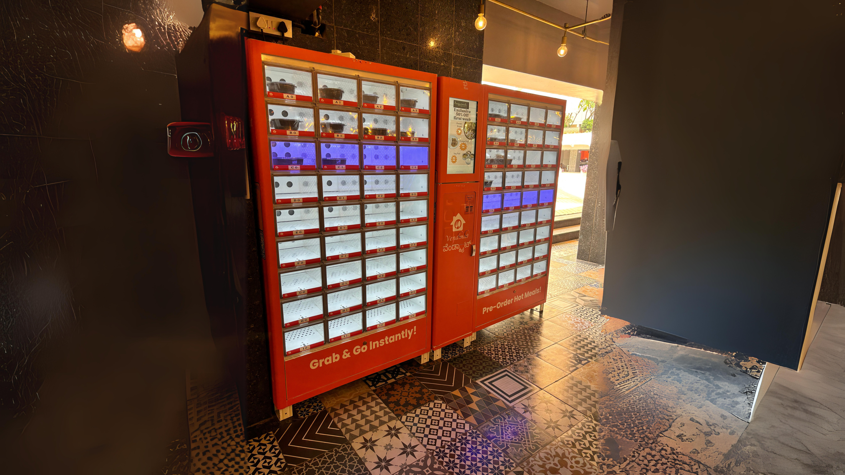



Vendmat
Vending Machine + Automat
Temperature Controlled
Fastest
A constant temperature of 60 degrees Celsius is maintained to preserve food for a longer duration.
Hot food delivered in less than 10 seconds
Consumer Application
Hygienic
Customers can pre-order from listed restaurants or grab food directly from the machine accessible through the application.
Fully Automated, No need to use machine screen to order
3

Slide 4

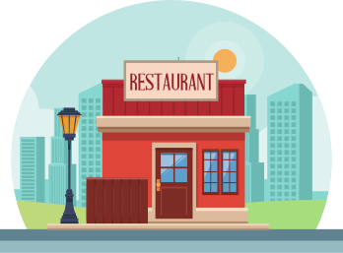
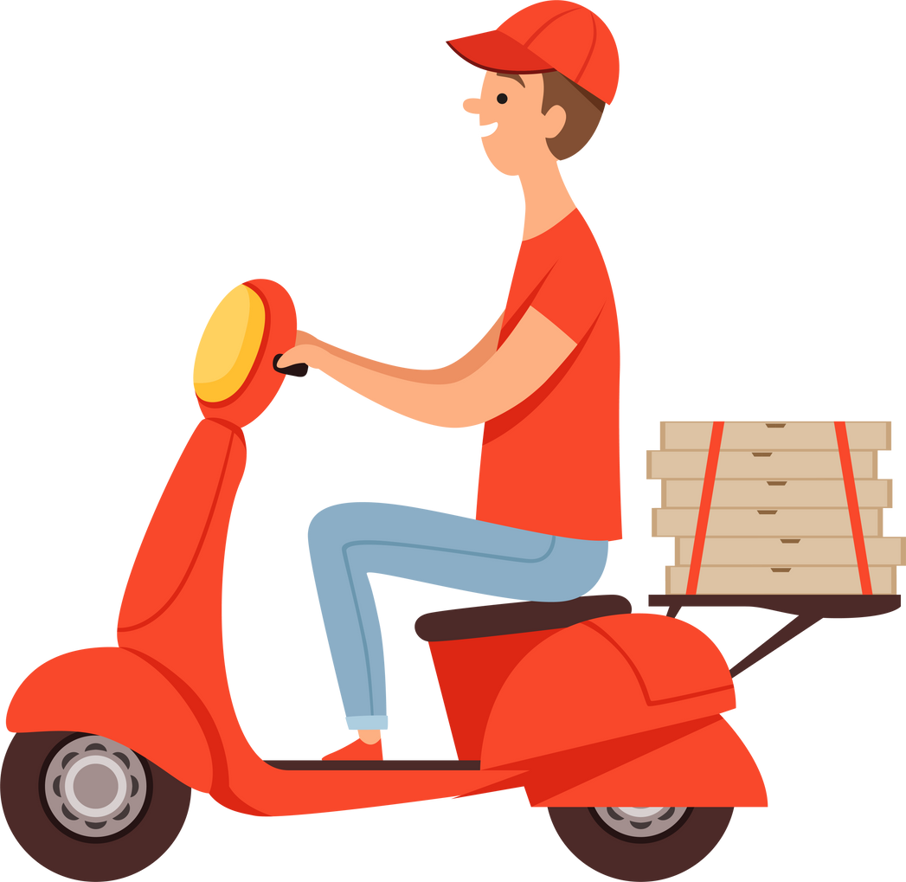
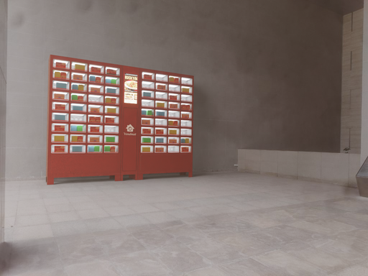
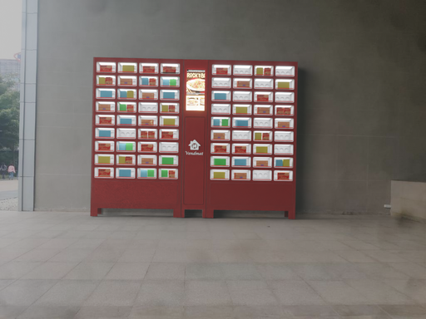




Vendmat Concept
Pickup from Restaurant
Arrive at designated place
Customer
4
Take out
Order/Pay
Put into Vending Machine

Slide 5
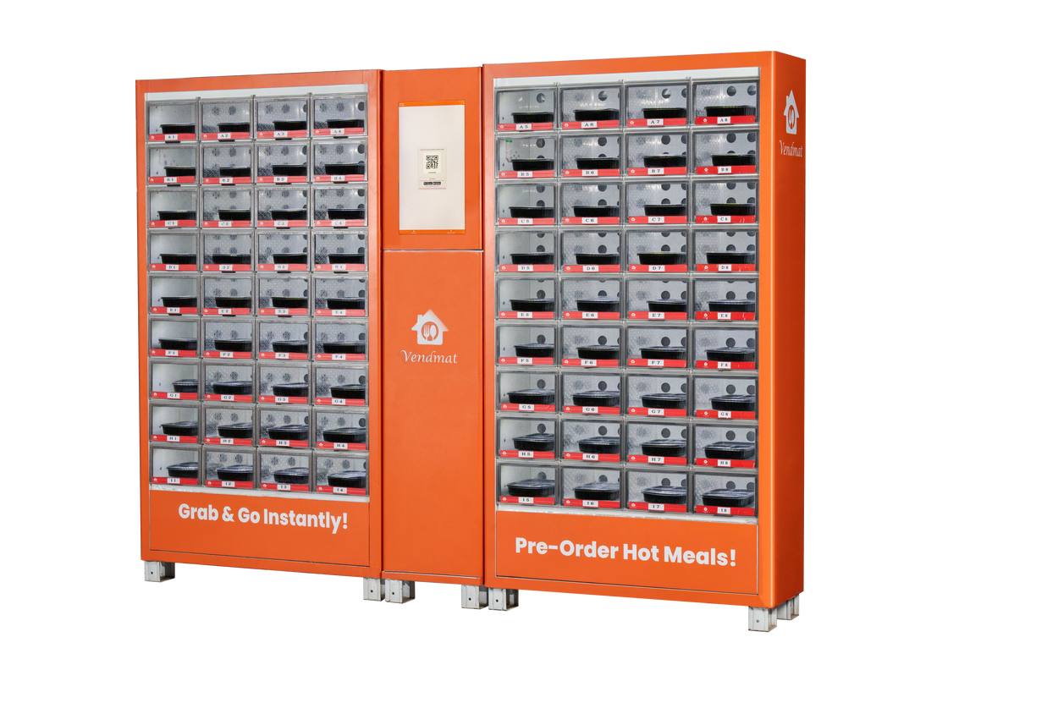
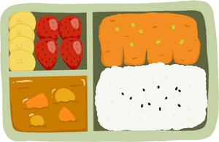
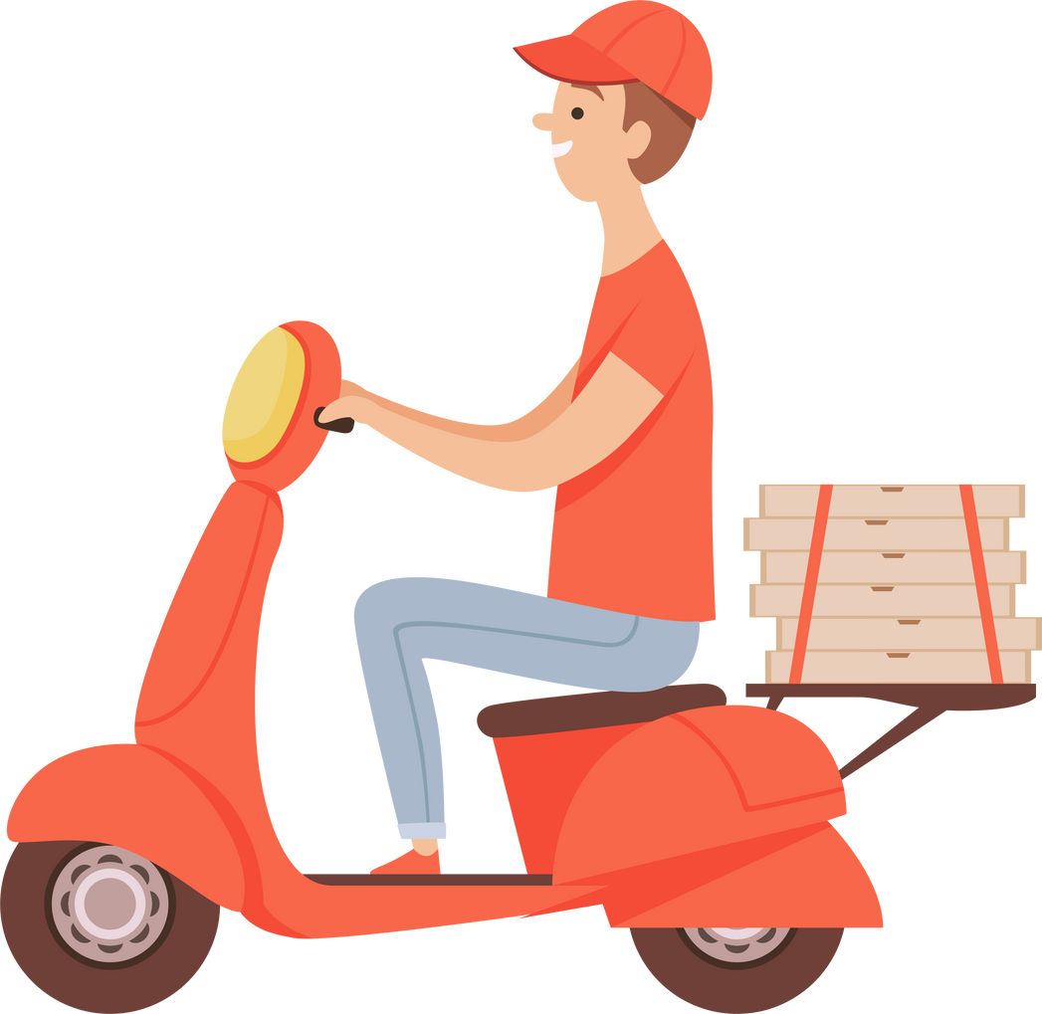
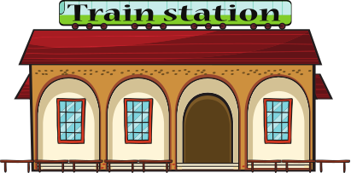


Revolutionize Foodservice.
Assisting Food Service Companies in Broadening Sales Channels
Utilize cloud kitchens as central food suppliers
Employ Vendmat Machines as distribution points
Extend sales channels from restaurants to office building lobbies, colleges, metro stations and hospitals
Costs less than half of a food delivery platform
5

Slide 6
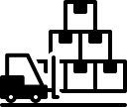





Unfair Advantage
18x Efficient Delivery
Reduced Capex
Bulk delivery of 72 food items each in four set time slots.
Vendmat Handles entire front end for kitchens, thus reducing their capex to launch in new locations
Improved Restaurant Profit Margins
Strategic Locations
Restaurants can increase their profit margins by reducing operational costs
Strategic placement of machines in high density locations
Focused Advertisement
Hot Food
Leveraging Mobile application and 22-inch screen on machine, we can display hyper local advertisements for participating restaurants
No Hassle to reheat food using microwave
6

Slide 7
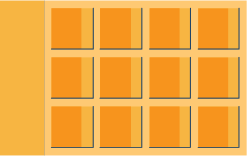

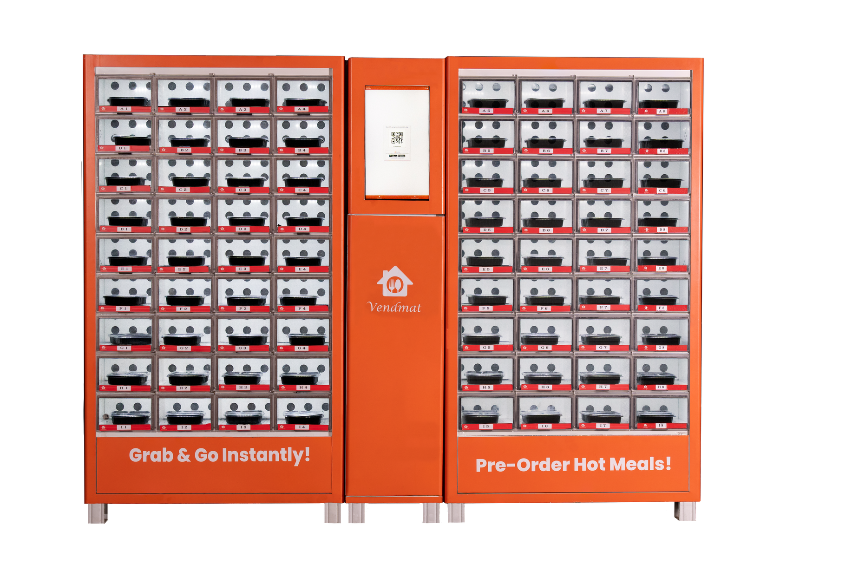


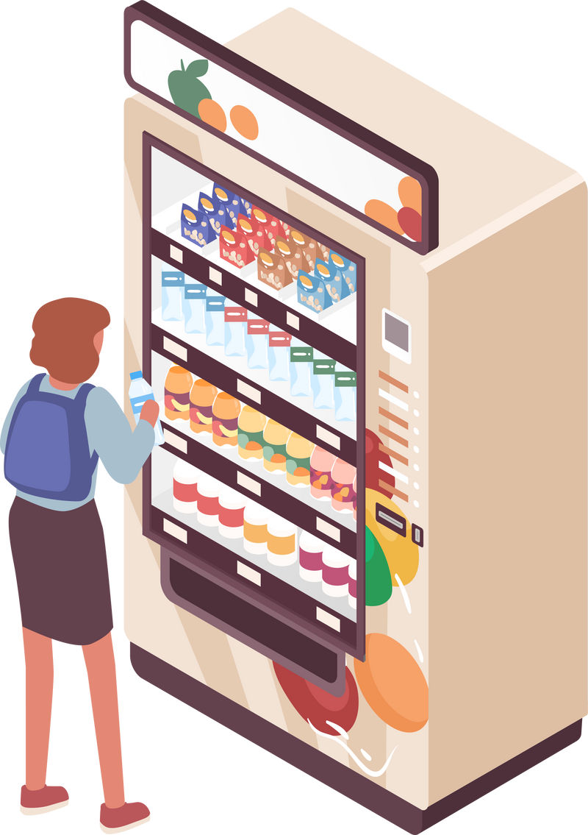
Restaurant Mobile Application
72 Cells per Machine
Business Model
Each cell can hold a single food box
Size of cell: 230(W) X 110(H) X 300(D)MM
Monitor sales
Control Food pricing in real time
Manage Menu
Package
Supply Chain Management
Advertising Opportunities
Efficient and reliable supply chain solutions to ensure timely delivery and restocking of food items.
Ability to display ads on the vending machine's digital screen, promoting your brand and menu directly to potential customers.
Prime Location Access
Placement of vending machines in premium, high-traffic locations, maximizing visibility and sales potential.
7

Slide 8
Size of the market
65 Lac+ Locations
2 Lac
Locations
20 K
Locations
Potential locations (India)
Total Addressable Market(TAM) for vending machines
High density Locations (India)
Serviceable Available Market(SAM) for hot food vending machine
High density Locations (Tier 1 cities)
Serviceable Obtainable Market(SOM) for Vendmat
8
Reference: https://www.daalchini.co.in/blog/vending-machine-market-size/

Slide 9
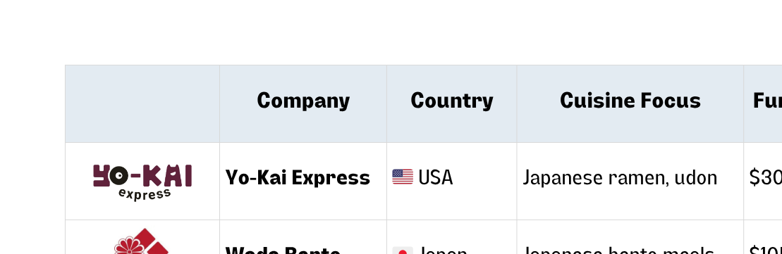
Hot Food Vending: A Proven Global Concept, Localized for India
Companies worldwide have successfully deployed hot food vending systems. Vendmat builds on these proven models with a strong focus on Indian meals, rapid delivery, and tech-enabled operations.
The future of hot food access is smart and fast
Vendmat brings this innovation to India’s high-density lunch market with unmatched speed and local flavor.
9

Slide 10
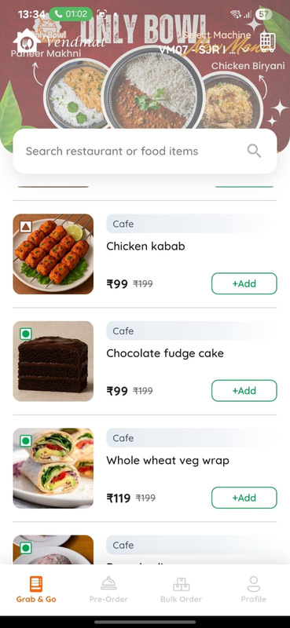
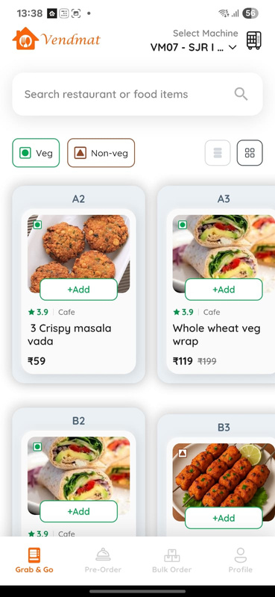
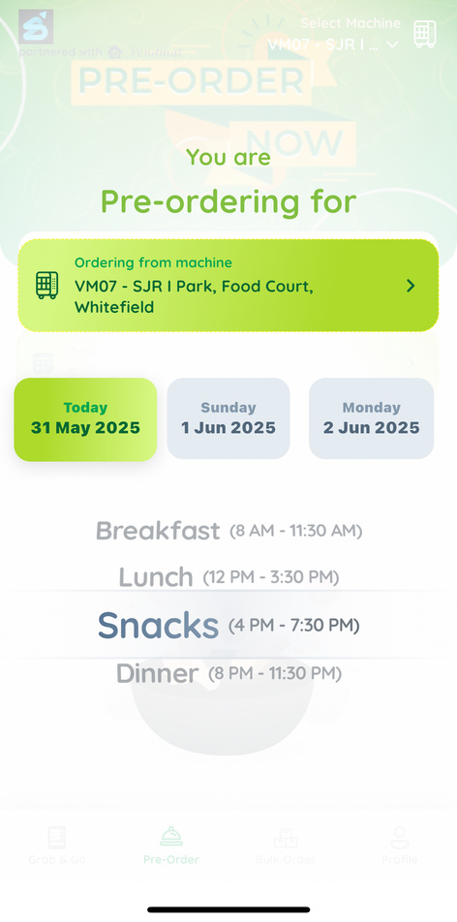
Consumer App
Grab N Go
Reimagined Menu Listing
Pre Order
List of Food Items currently available in the Machine
Order upto 2 hours before a delivery time slot
Menu organized by machine slots.
10

Slide 11
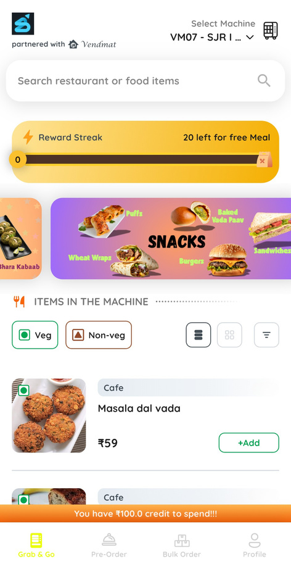
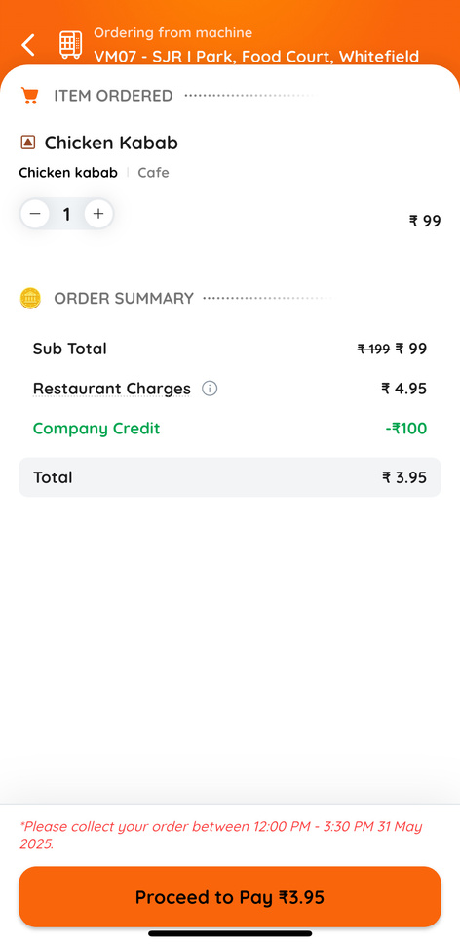
Corporate Tie up
Customization
Easy Checkout
Company logo visible only to its employees
Credits automatically applied at checkout!
Company Logo
Company credit used during checkout.
Free credits for the day
11

Slide 12
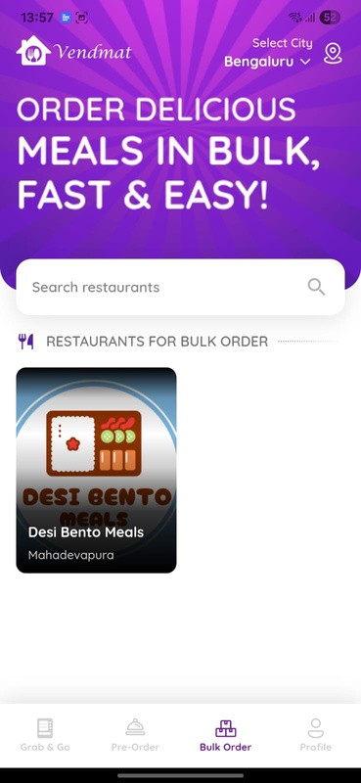
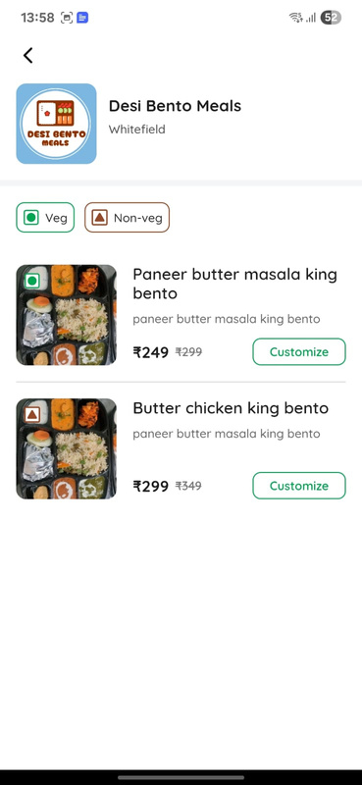
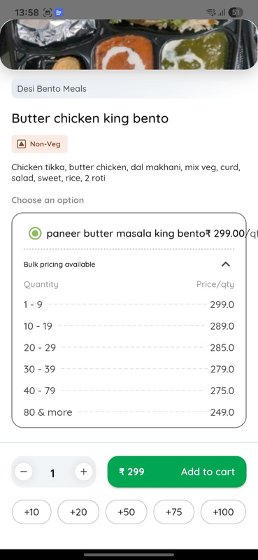
Bulk Ordering
Bulk Ordering
Menu Mangement
Dynamic pricing
Bulk Order restaurant list
Manage different menu
Price based on quantity .
Minimum order value - Rs 3000
12

Slide 13
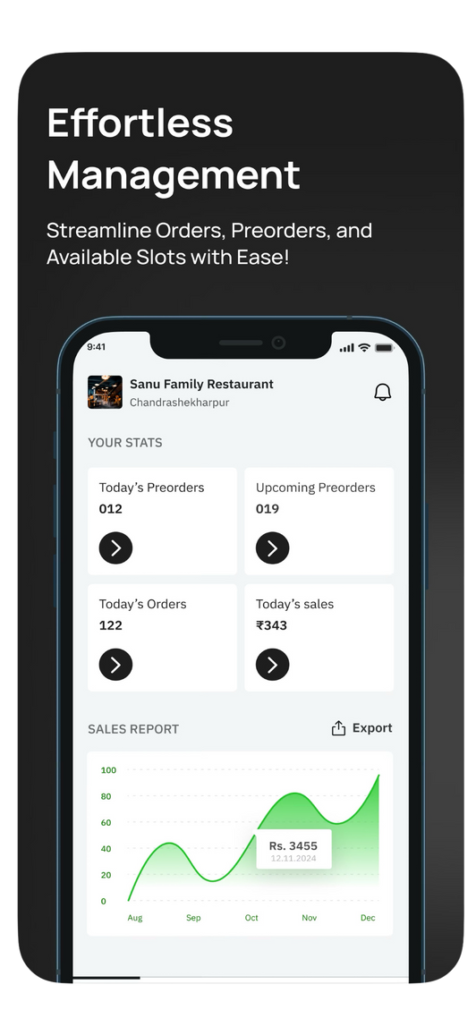
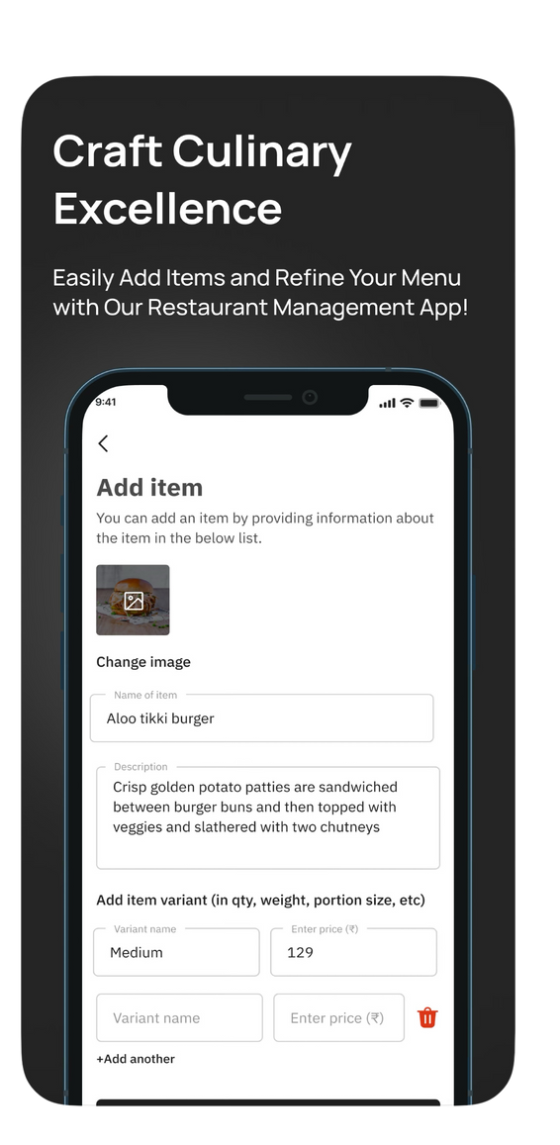
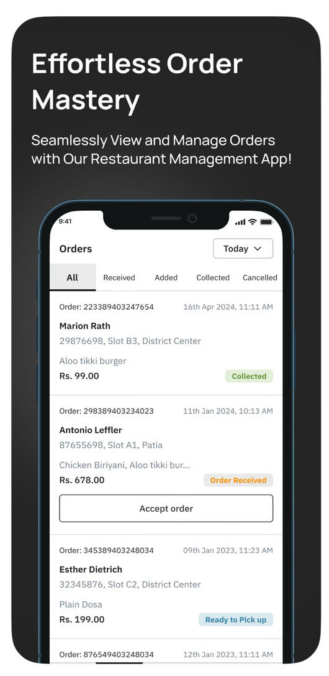
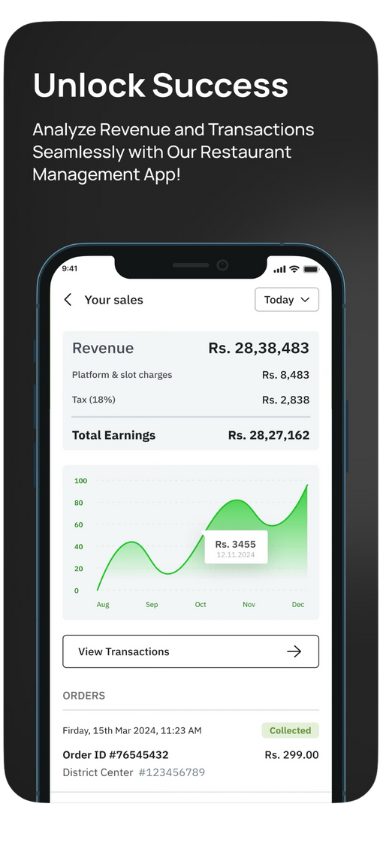
Restaurant App
13

Slide 14
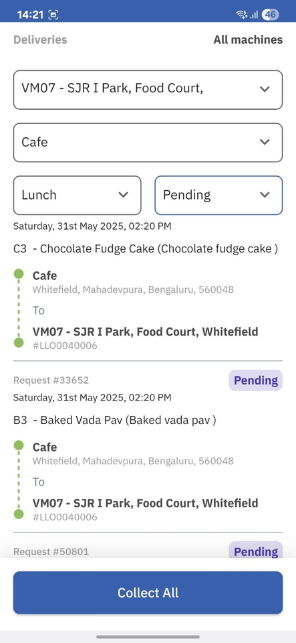
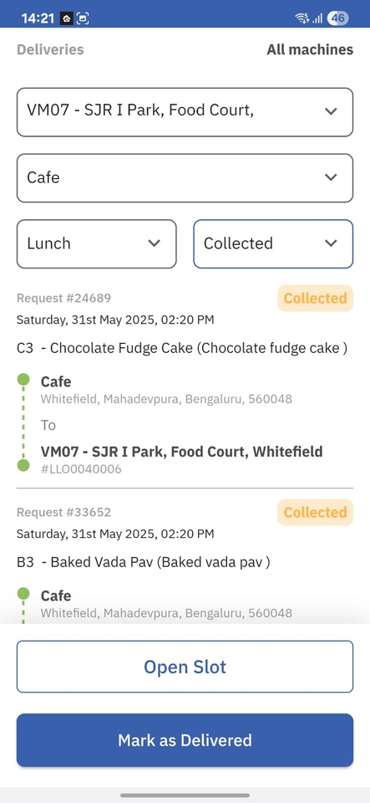
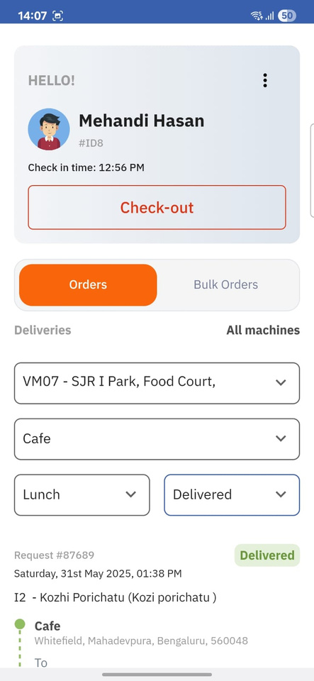
Delivery App
Clear Slot Instructions
Smart Slot Control
Final Review Summary
Shows exact food items and target slots for delivery.
Delivery boy opens slots, marks items delivered accurately.
Lists all filled items with delivery details for verification.
14

Slide 15




Real-World Traction & User Behavior Insights
Traction Highlights
Customer Behavior Insights
Growth Opportunities
Rentention First-Business model
3 machines live across Bengaluru tech parks (SJR, Ecoworld, Azure)
3,000+ orders served
60%+ repeat usage across all machines
Top users placed 40+ orders each
Category demand differs by location: SJR & Azure focus on snacks, while Ecoworld has balanced demand.
Users starting with snacks often opt for full meals, creating upsell opportunities.
Strong adoption in Ecoworld despite launch on Feb 17 – indicates product-market fit
Underutilized slots: Breakfast & late-night
Add loyalty/reward features to convert 1-time users
Users who experience Vendmat tend to return consistently.
There is strong engagement from dedicated customers, resulting in a quick recovery of customer acquisition costs.
15

Slide 16

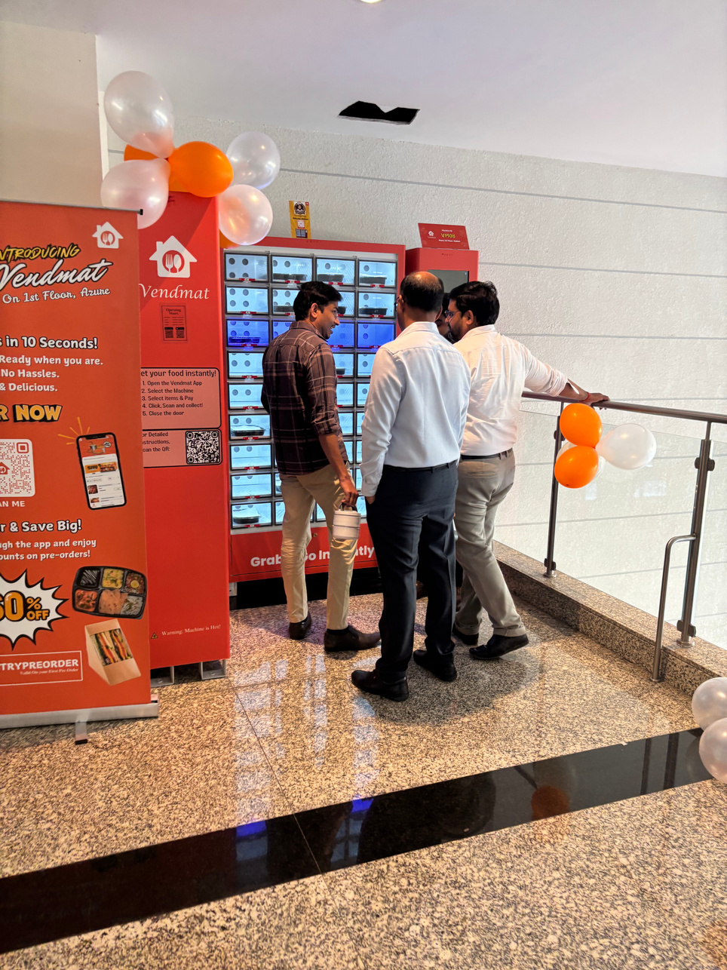
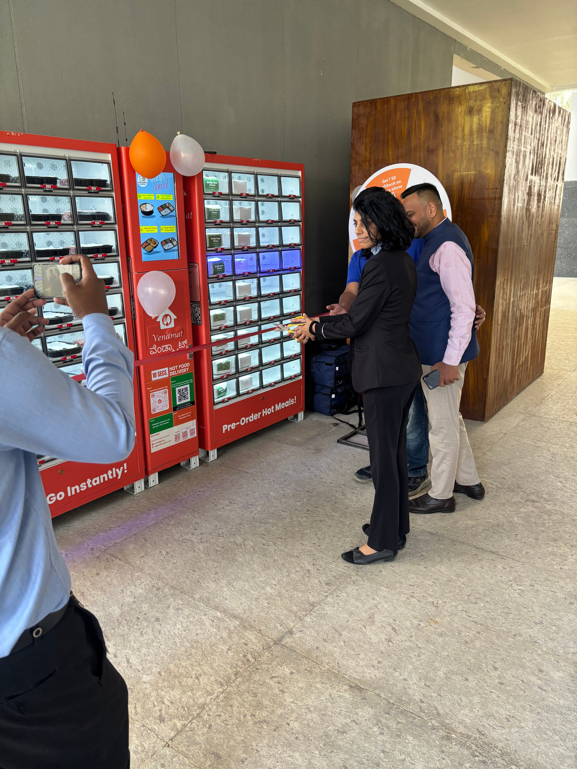
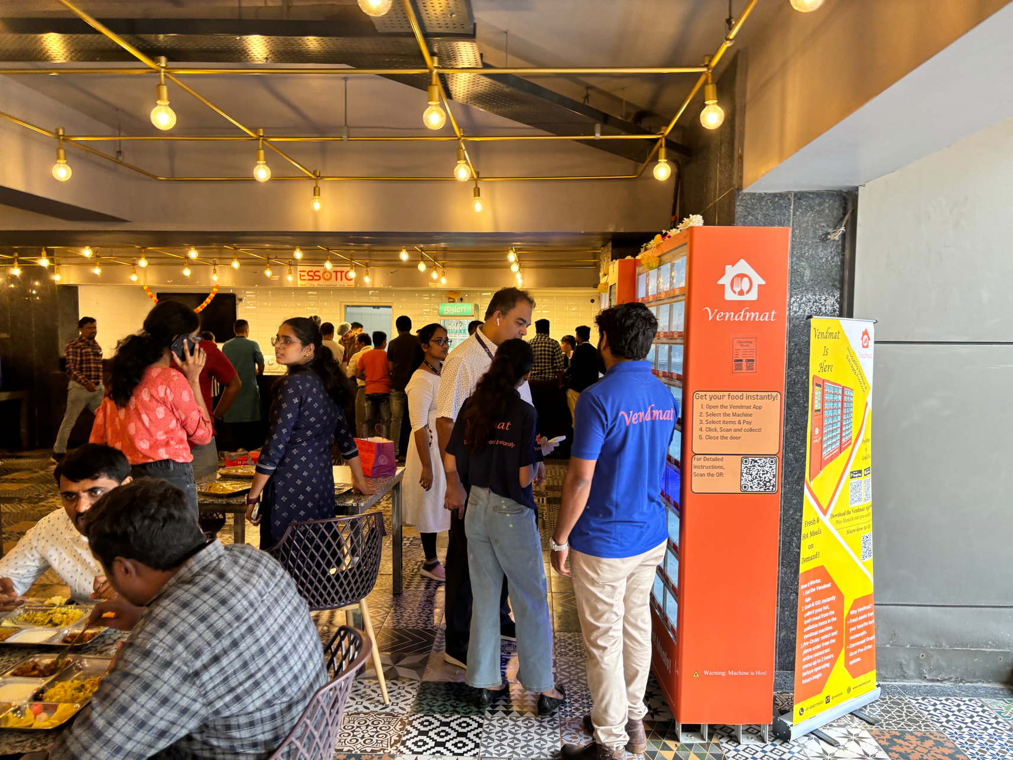
Validating the Model, One Meal at a Time
16

Slide 17
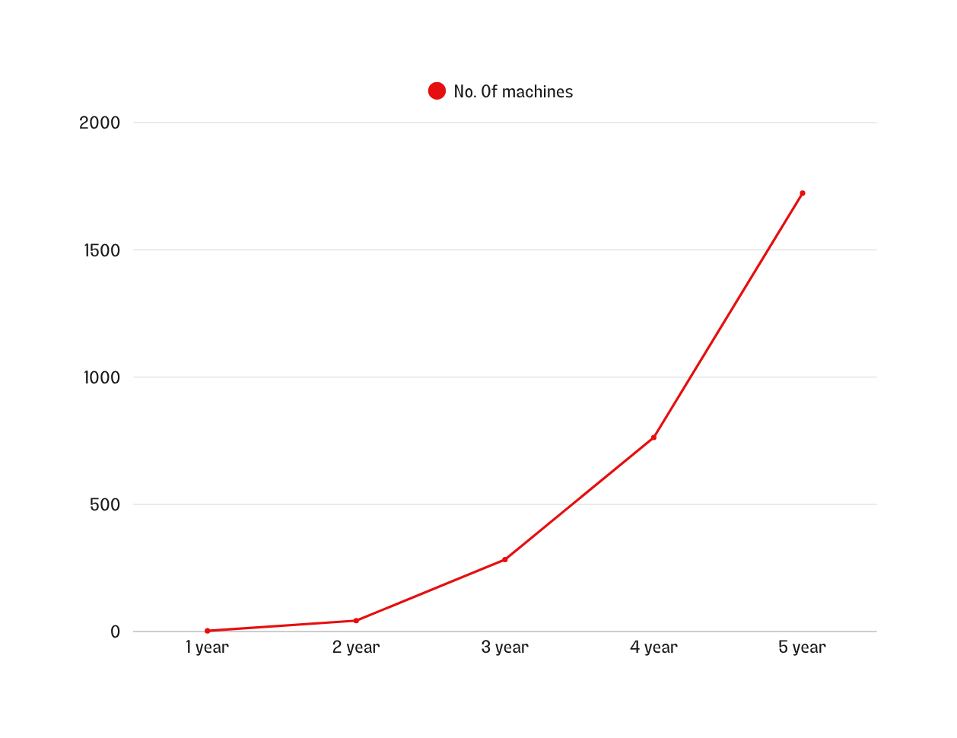
5 Year Projections
Year 1
3 Machines with consistent profits
Year 2
Install 40 Machines
Year 3
Install 240 machines
Year 4
Install 480 machines
Year 5
install 960 machines
Timeline
17

Slide 18
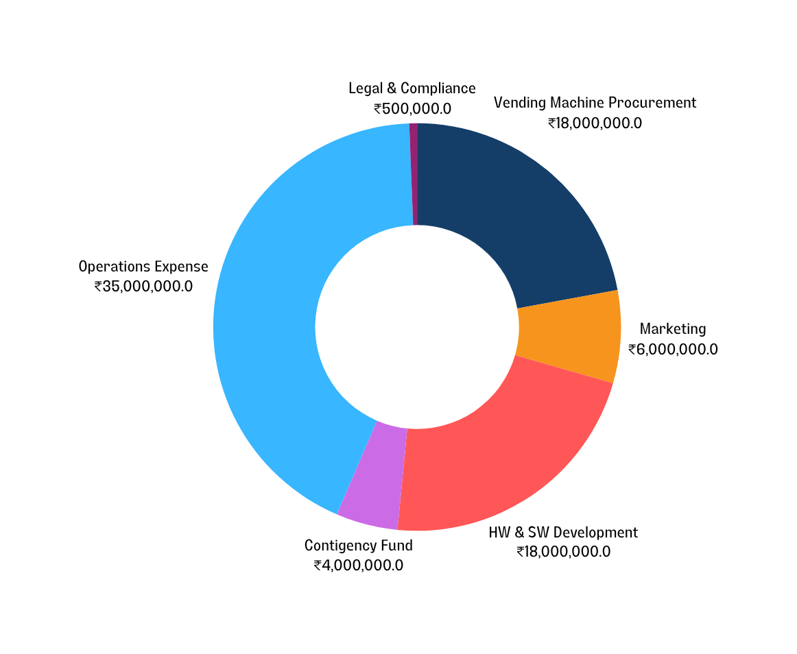
Fund Requirement plan for 18 Months
The Ask
₹8.15 Crore seed
Goal:
Install Machine
Develop New Machine
40 Machines will be installed
Bring down cost per machine
Customer Experience
Marketing
Create awareness about vendmat
Boost Support and retention
18

Slide 19




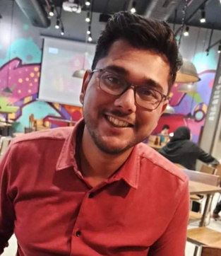
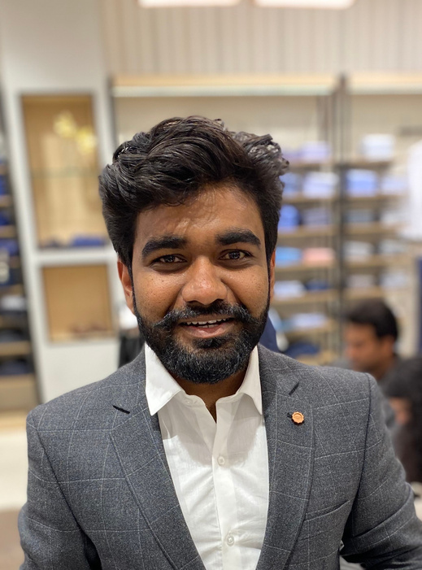

Team
Pranay Kukreti
Shreyas Belgave
Founder
Mtech - VIT, Vellore
Lead Engineer - Qualcomm
Business Development / Operations
Founder
Mtech - VIT, Vellore
Senior Engineer - Texas Inst.
Technical/Customer Support
19

